Slide 1

English Edition
MAIBAHE · 麦吧呵
Good Food, Good Deeds
Product Catalog 2026 · Wholesale · OEM · Private Label
maibahe.uk · maibahe001@hotmail.com

Slide 2

ABOUT US
Why Global Buyers Choose Maibahe
Maibahe is a brand of Guangdong Weikang Group, built on one belief: good food starts with good deeds. Since 2018 we have connected four protected origins across China — the Horqin sandy land, the Hongyuan plateau, the Northeast black bee reserve and the Dabie Mountains — directly to food brands, importers and retailers worldwide. Every pallet carries a traceable story: who grew it, where it grew, and which laboratory verified it.
2,000+
4
Retail Stores in China
Protected Origin Bases
3
2018
Organic Certs CN·EU·USDA
Established
MAIBAHE · Product Catalog 2026
02 / 12

Slide 3
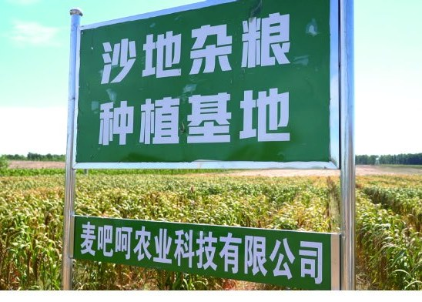

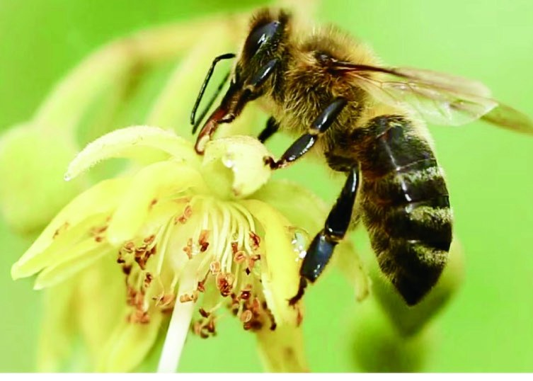

ORIGINS
Sourced Where It Grows Best
Sandy Land Farms
Hongyuan Plateau
42°N · INNER MONGOLIA · HORQIN
3,500 M · SICHUAN
Grains on mechanically levelled dunes, irrigated with 70-metre alkaline groundwater; exclusive "Baiyan 26" oat variety.
Maiwa yaks, a national geographical indication breed, on natural alpine meadow; triple organic certified.
Northeast Forest Reserve
Jinzhai County
HEILONGJIANG · RAOHE
ANHUI · 31°N · DABIE MOUNTAINS
Apiaries inside the 1997 national nature reserve — the only bee reserve in China; EU organic standard.
Oak-log lingzhi at 31°N; CN/EU/JAS organic spore powder, 99%+ wall-breaking, PICC insured.
MAIBAHE · Product Catalog 2026
03 / 12

Slide 4
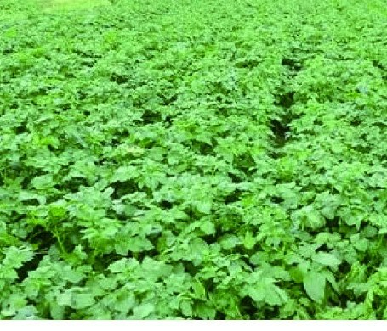
PRODUCT LINE 01
Sandy Land Grains
Oats, millets, black rice and multigrain congee mixes from 42°N Horqin sandy-land farms — irrigated with 70-metre alkaline groundwater and built on our exclusive "Baiyan 26" oat variety. Large day-night temperature swings and a long cycle concentrate nutrients in smaller, denser grain.
42°N Horqin Origin
Baiyan 26 Variety
Whole Grains & Flakes
maibahe.uk
MAIBAHE · Product Catalog 2026
04 / 12

Slide 5
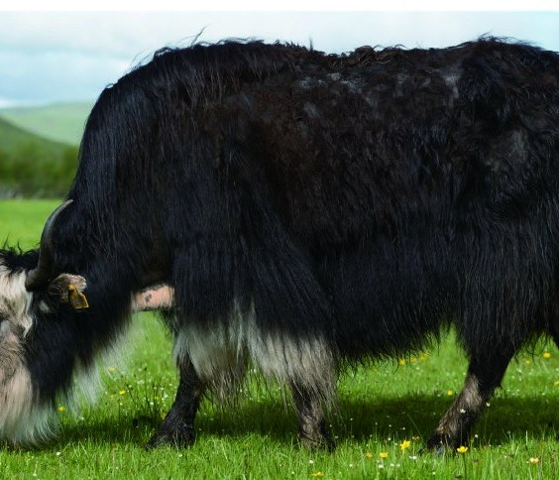
PRODUCT LINE 02
Highland Yak Dairy
Yak milk powders from 3,500m Hongyuan pastures — Maiwa yak, a national geographical indication breed, holding China, EU and USDA organic certification. Higher in protein with a rich, creamy flavor; OEM specifications available.
3,500m Plateau Pasture
Tri-Organic CN·EU·USDA
GI Breed
maibahe.uk
MAIBAHE · Product Catalog 2026
05 / 12

Slide 6
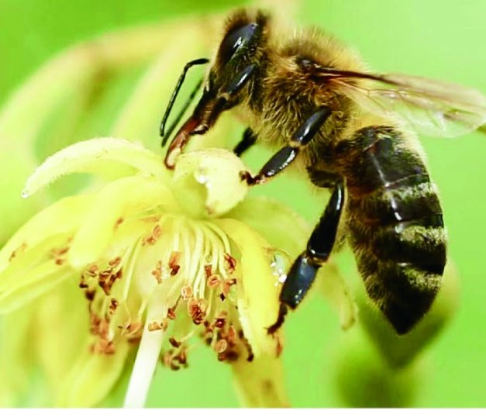
PRODUCT LINE 03
Northeast Black Bee Honey
Linden honey from apiaries inside the 1997 national nature reserve — the only reserve in China protecting a bee species. Meets EU organic standards, with 200+ contracted beekeepers for batch-level traceability.
1997 National Reserve
EU Organic Standard
200+ Contracted Beekeepers
maibahe.uk
MAIBAHE · Product Catalog 2026
06 / 12

Slide 7
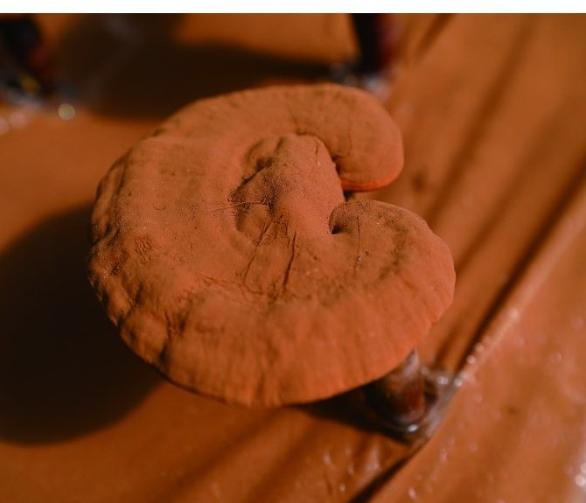
PRODUCT LINE 04
Jinzhai Botanicals
Oak-log lingzhi and spore powder from 31°N Jinzhai — certified organic in China, the EU and Japan. Ultra-low-temperature physical wall-breaking reaches 99%+ with no heavy metals; PICC insured.
31°N Dabie Origin
CN·EU·JAS Organic
99%+ Wall-Breaking
maibahe.uk
MAIBAHE · Product Catalog 2026
07 / 12

Slide 8
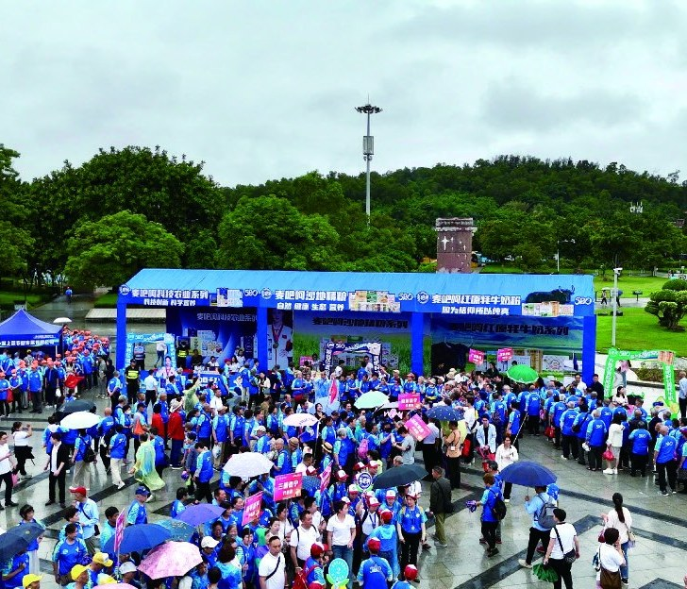
PRODUCT LINE 05
Selected Pantry Staples
Red dates, goji berries, black fungus and ready-to-cook grain kits — sourced from the same protected origins, available in bulk or private-label packaging.
Bulk Supply
Private Label
Ready-to-Cook Formats
maibahe.uk
MAIBAHE · Product Catalog 2026
08 / 12

Slide 9
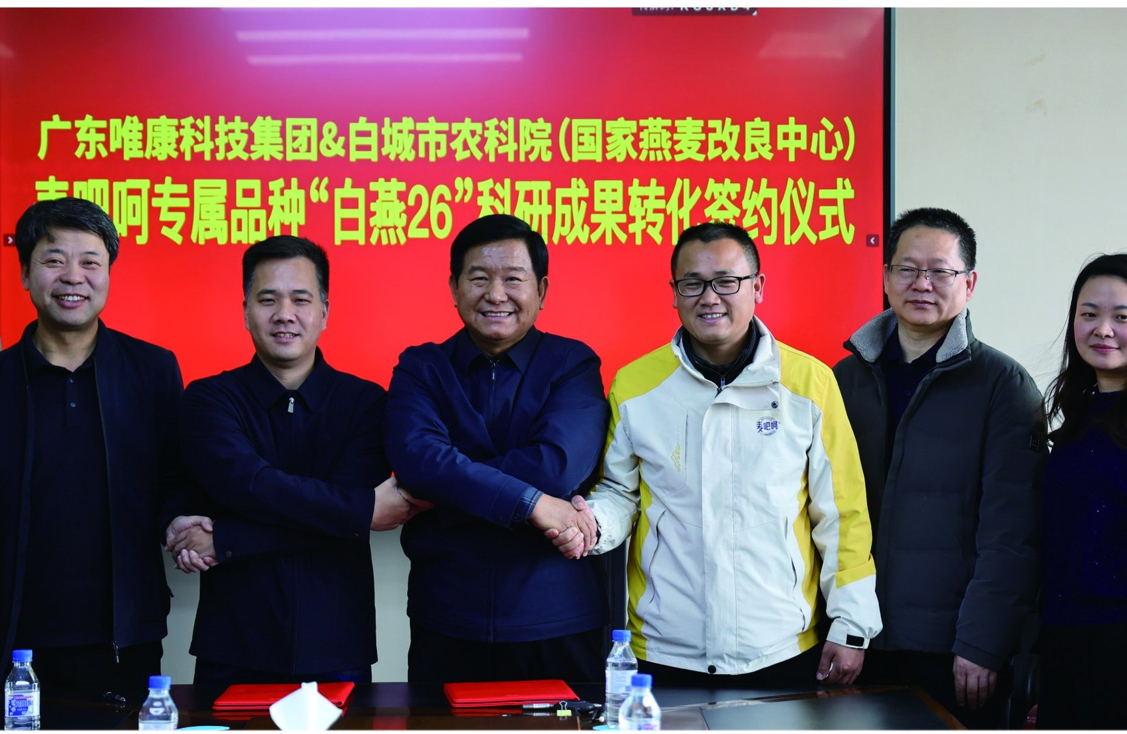
QUALITY & CERTIFICATIONS
Certifications You Can Put on the Label
Yak dairy line
China organic CN-BIO-154 (ECOCERT) · EU organic · USDA organic; Hongyuan yak national GI
Lingzhi spore powder
China organic 1150P1701677 · EU organic · Japan JAS; PICC insured
Black bee line
1997 national nature reserve · EU organic standard
Every shipment
Batch QC reports + certification documents; open to third-party audits
RESEARCH
In May 2021 we signed with the China National Research Institute of Food & Fermentation Industries to establish the Maibahe Bioactive Peptide Research Center, and with the National Oat Improvement Center to convert our exclusive "Baiyan 26" variety into commercial production.
2,000+ Retail Stores in China
3,500 M · SICHUAN
Batch QC reports and certification documents accompany every shipment; third-party factory audits (SGS / BV / Intertek) are welcome.
MAIBAHE · Product Catalog 2026
09 / 12

Slide 10
OEM / PRIVATE LABEL
From Pilot Run to Full Container
01
02
03
04
Inquiry & Requirements
Quotation & Proposal
Sampling
Contract & Production
Share your target products, specs, volumes and market regulations; capability assessment within 24 hours.
Detailed pricing, MOQ options, lead times and packaging — including compliance for your market.
Free standard samples (freight collect) shipped within 10–15 business days.
25–35 days after deposit; T/T payment; EXW / FOB / CIF / DDP supported.
Single-Pallet MOQ
Multilingual Labeling
Open to Third-Party Audits
MAIBAHE · Product Catalog 2026
10 / 12

Slide 11
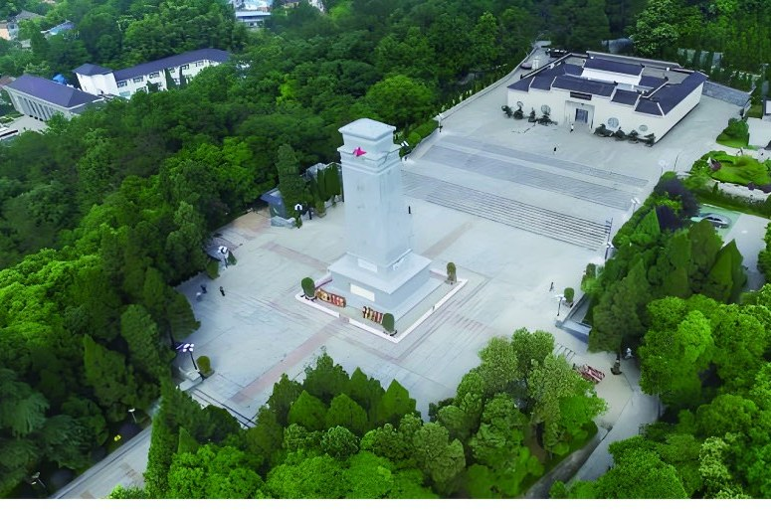



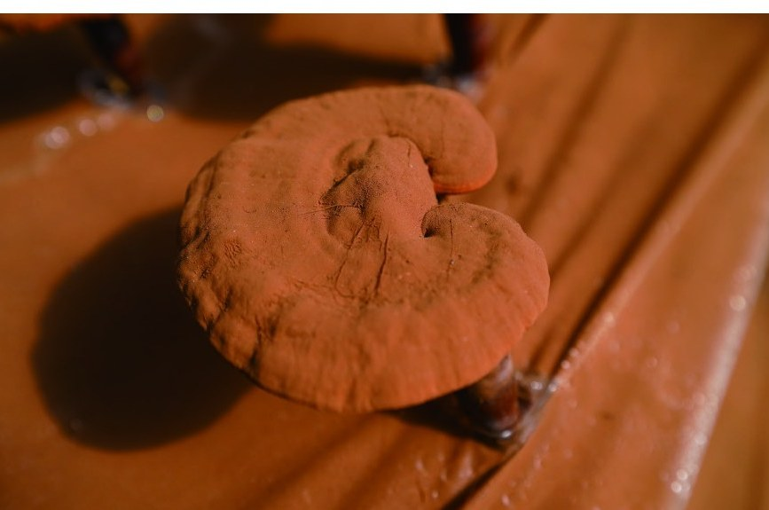

Four Protected Origins
Sandy land, plateau, forest and medicinal vault — every frame from our own bases.
MAIBAHE · Product Catalog 2026
11 / 12

Slide 12
Start a Conversation
EMAIL
maibahe001@hotmail.com
WHATSAPP
+86 136 6099 6199
WEBSITE
maibahe.uk
Zhaoqing, Guangdong, China · Guangdong Weikang Group
Good food, good deeds.
MAIBAHE · English Edition
MAIBAHE · Product Catalog 2026
12 / 12

